Slide 1
Minor project
Automated ad-profiling and ad-detection using convolutional neural networks
PROJECT GUIDE: DR. ARUNA TIWARI
STUDENT NAME: ANIRBAN NATH
ROLL NO.: 2104101001

Slide 2
MOTIVATION
Online advertising has been steadily growing over the past few years and today, fueled by the rise of OTT platforms, there are more players in this space than ever.
As people move increasingly away from traditional media such as TV and newspapers and more towards OTT platforms, there is a big opportunity for increased ad-revenue.
The above can be achieved by diversification i.e. by showing different advertisements on different platforms, OTT content companies can multiply their ad-revenue as well as serve curated ads to the viewer.

Slide 3
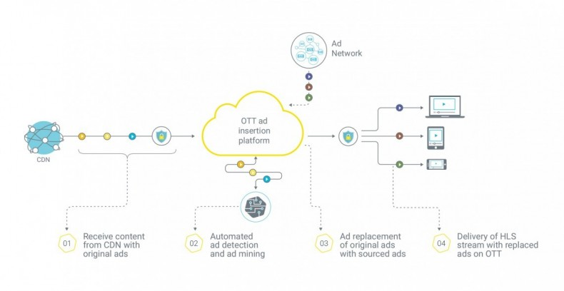
Project deals with this phase
of the pipeline
Source: streamingmedia.com

Slide 4
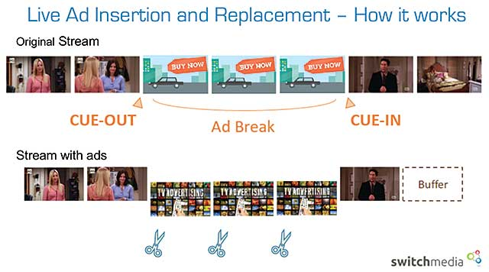

Slide 5
TECHNICAL CHALLENGES AND REQUIREMENTS
In the absence of ad markers in the incoming broadcast feeds, it’s almost impossible to know where to insert a personalized ad within any given stream.
Different ads use different resolutions and contain widely differing artefacts within them : some use only graphics, some are almost movie-like.
Framerates vary between different channels, ranging anywhere between 23 – 30 fps.
All ads must be processed and matched in near real-time.

Slide 6
proposed pipeline
Create ad-signatures from the available database of advertisements
Database of Ad-Signatures
(Pre-processed)
OTT
Stream
Use database to find when an ad starts and how many frames it runs for
Output Stream with ad markers

Slide 7
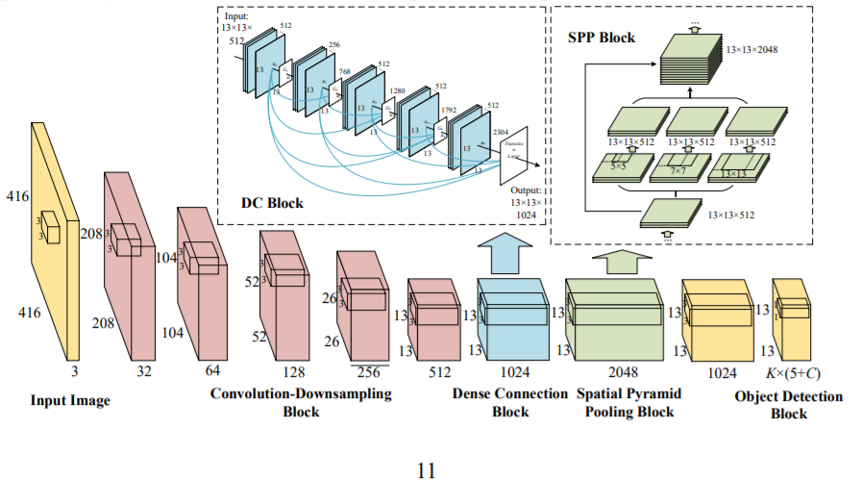
ALGORITHM:
YOLOV3 - SPP
{ Why use SPP? : The Spatial Pyramidal Pooling or SPP block is a pooling layer that removes the fixed-size constraint of the network by using pooling filters of varying dimensions to give an output that has fixed dimensionality irrespective of input image resolution. }

Slide 8
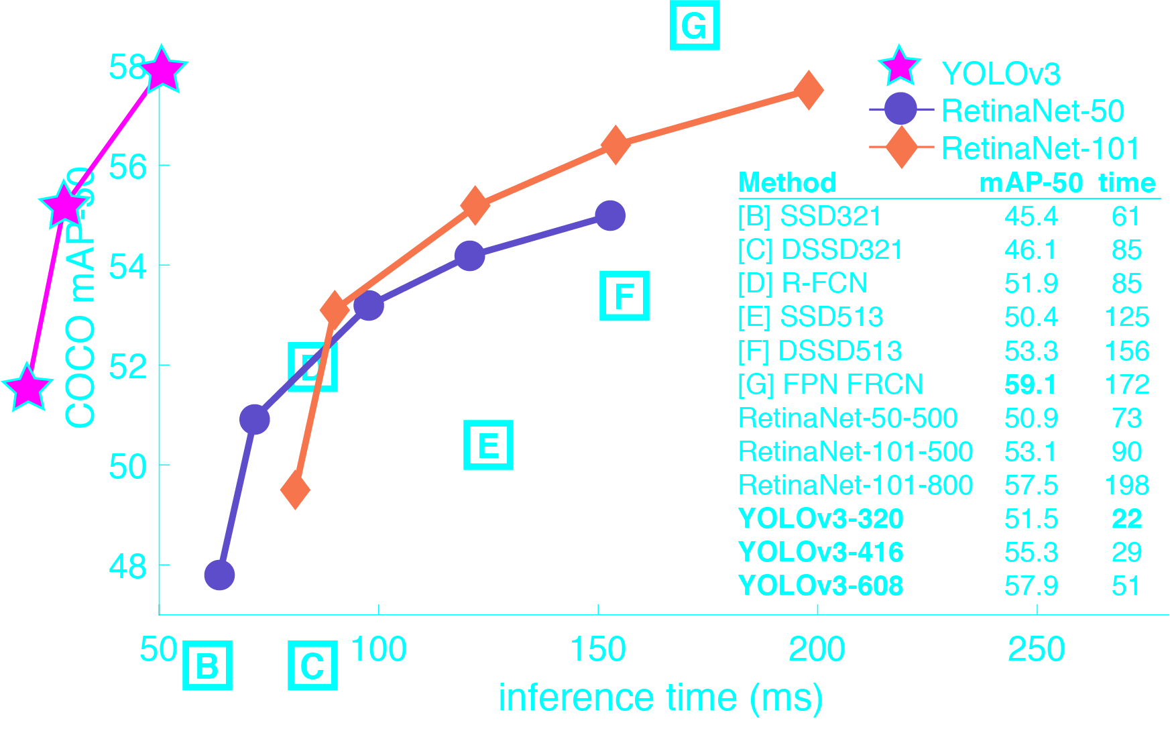
Source: https://pjreddie.com/darknet/yolo/

Slide 9
Lit. review 1
Covell, Michele, Shumeet Baluja, and Michael Fink. "Advertisement detection and replacement using acoustic and visual repetition." In 2006 IEEE Workshop on Multimedia Signal Processing, pp. 461-466. IEEE, 2006.
This paper proposes a two-pass algorithm for ad detection. An audio snippet match, followed by video verification of the starting and ending frames using pixel matching. The algorithm requires the creation of a large database of audio query snippets and video snippets and the visual matching is done after reducing each frame of the video to 5x5 24bit image, which obviously loses out on detail. Furthermore, this approach is time consuming. Also, audio and video are often broadcast as different HLS streams, which may cause further discrepancies.

Slide 10
Lit. review 2
Cardinal, Patrick, Vishwa Gupta, and Gilles Boulianne. "Content-based advertisement detection." In Eleventh Annual Conference of the International Speech Communication Association. 2010.
This paper too stresses on using audio matching for ad-detection known as the energy-difference fingerprint. The authors take a window of audio and match it to the clips at hand. They take 15 bits/frame (low-bitrate) and match it to the query audio clip after passing through a low-pass filter and Fourier transformation. They also use the nearest-neighbor kernel found in the CUDA library to cross-check the audio match by comparing frames of the video to frames of the ads.
Their combined two-pass approach performs at 0.003x real time, processing 322 ads during their testing. Our process takes 0.0004 seconds for frame-matching, which can do almost 4700+ ads in real time.

Slide 11
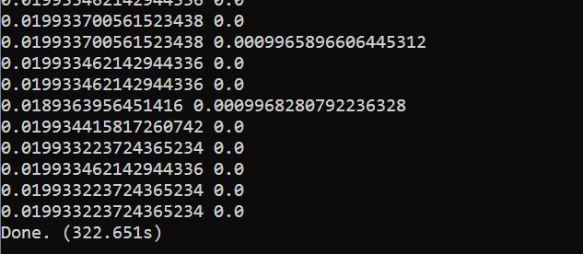
PERFORMANCE
To process this 10-minute video, the algorithm took 322.651seconds or 5.37 minutes
The first number in each row shows how much time it took to run inference on one frame to detect various objects (as per COCO dataset)
The second number says how much time was needed to match the total number of objects in the 125-frame sliding window with every ad-profile in the database.

Slide 12
CONSIDERATIONS and result
We use only one modality of matching (video) and so far, haven’t made considerations for frame drops as is typical with HLS streams. In its current state, the project focuses on exact matching.
This is an extremely lightweight application which is focused mostly on scalability.
Result: -
For a 25 fps stream, we get one frame every 1/25 = 0.04 seconds, which is how much time we have to process it. On an RTX 3060 mobile GPU, inference takes approximately 0.02 seconds (more or less constant).
This leaves us with 0.02 seconds for matching. At its current state, with a database of almost 120 ad signatures, we could make a prediction in 0.001 seconds. That means, we can theoretically expand our database 20x i.e. upto 120*20 = 2400 advertisements before we violate real-time inferencing with current hardware.

Slide 13
THANK YOU

